Slide 1
House Price Index Analysis
Group: 10
Members:
Sushwanth Reddy Boyapally
Pravallika Bodapati
Harshini Puskuri
Hong Shi

Slide 2
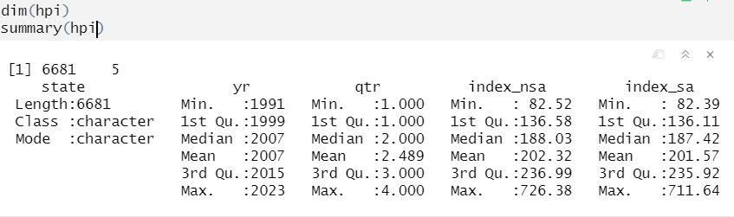
Data Sources:
The House Price Index (HPI) is a critical economic indicator that provides insights into the movement of single-family house prices.
HPI has 6681 variables and 5 features from January 1991 to August 2016 across the U.S., state.

Slide 3
Data Preprocessing
Create new variable “seasonal variation”
Formulate: seasonal variation = index_sa/index_nsa
Greater than 1: A seasonal variation index greater than 1 suggests that the seasonal component contributes more to the variability in the data than the non-seasonal component.
Equal to 1: If the seasonal variation index is equal to 1, it suggests that the seasonal and non-seasonal components contribute equally to the overall variability in the data.
Less than 1: A seasonal variation index less than 1 indicates that the non-seasonal component contributes more to the variability in the data than the seasonal component.

Slide 4
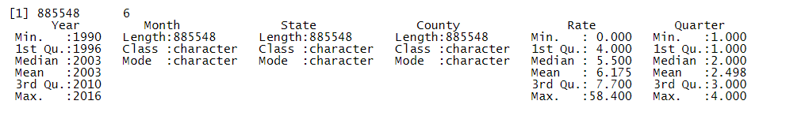
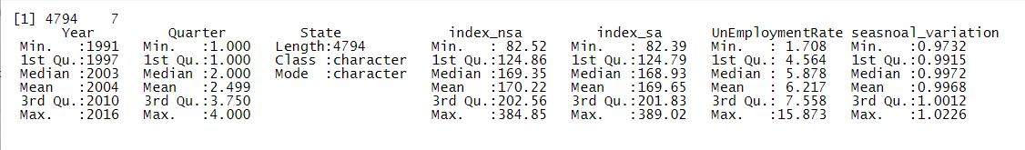
USA Unemployment Rate dataset, which includes 885548 variables and 6 features with the same period from January 1991 to August 2016 in the USA
After Data Clean and Merge we get a new dataset with 4794 rows and 7 columns.

Slide 5
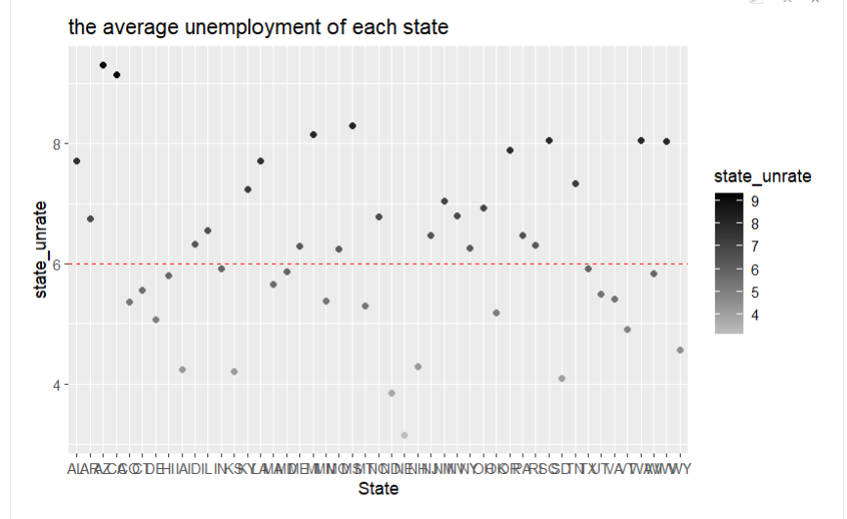
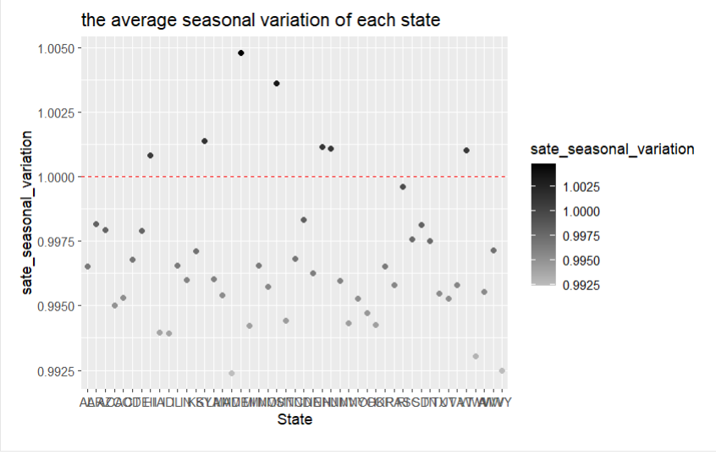
Data Visualization

Slide 6
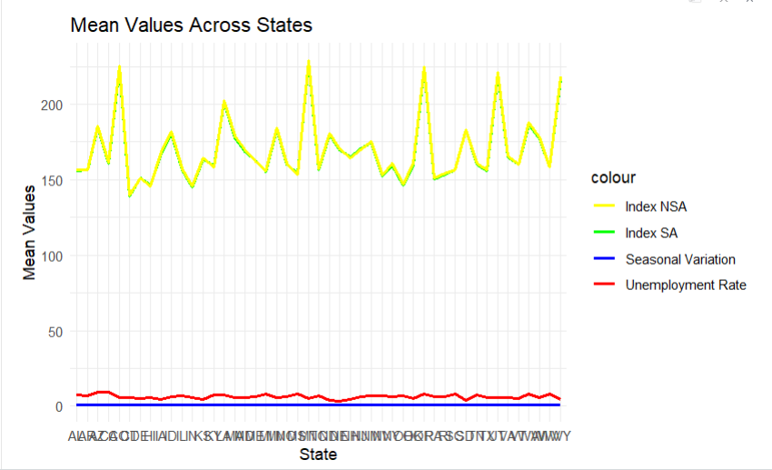
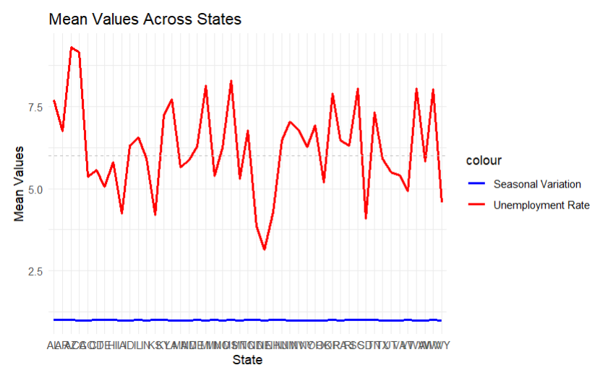
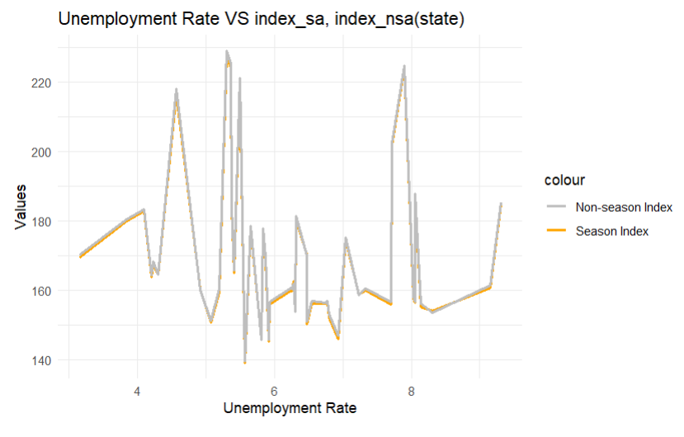
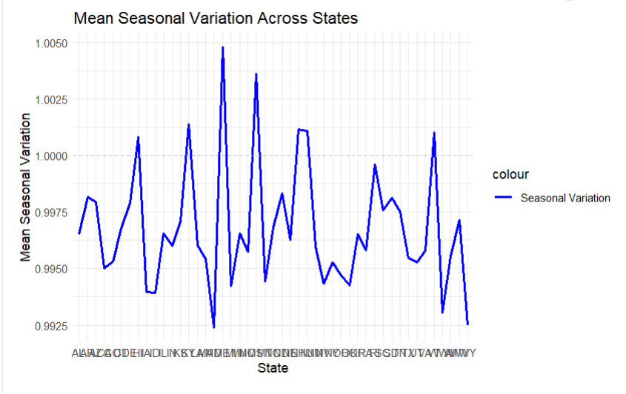

Slide 7
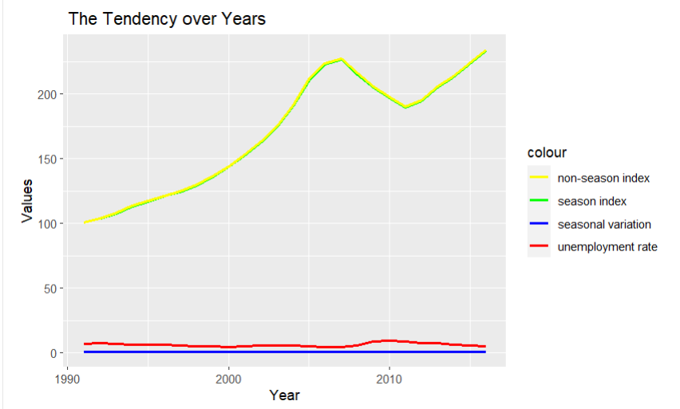
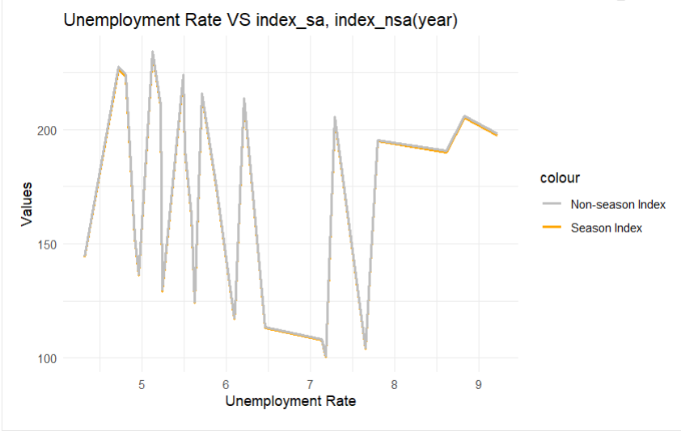
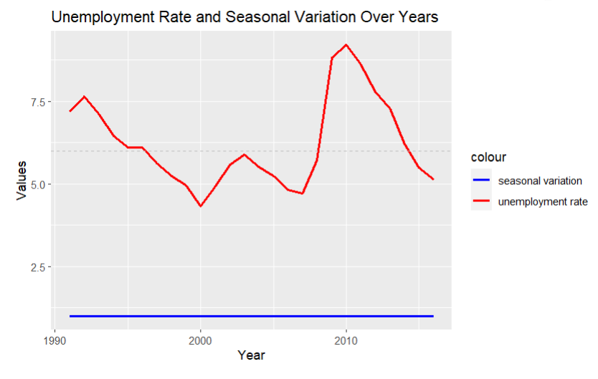
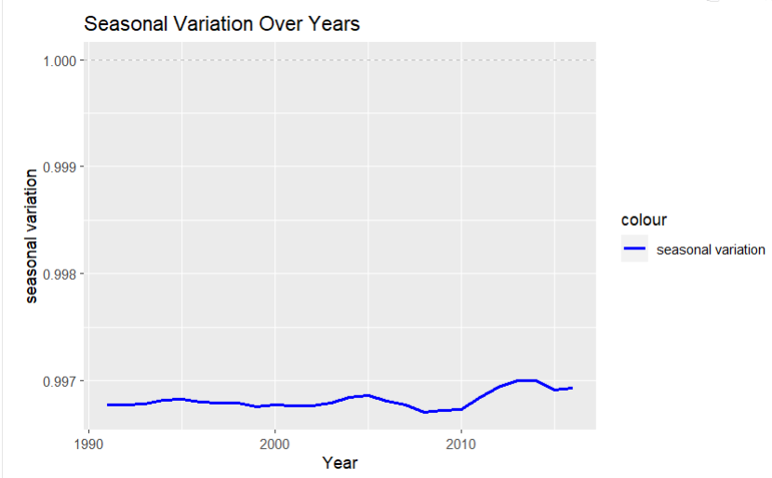

Slide 8
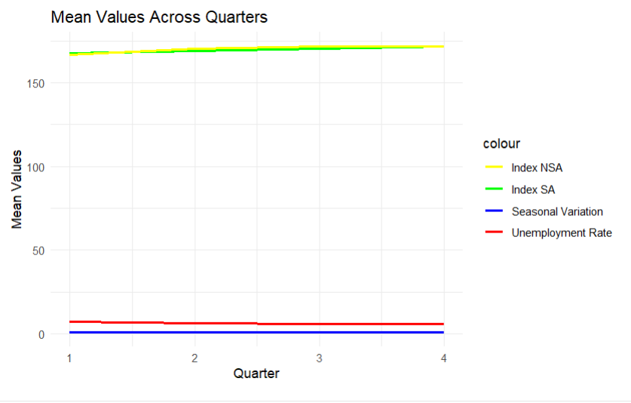
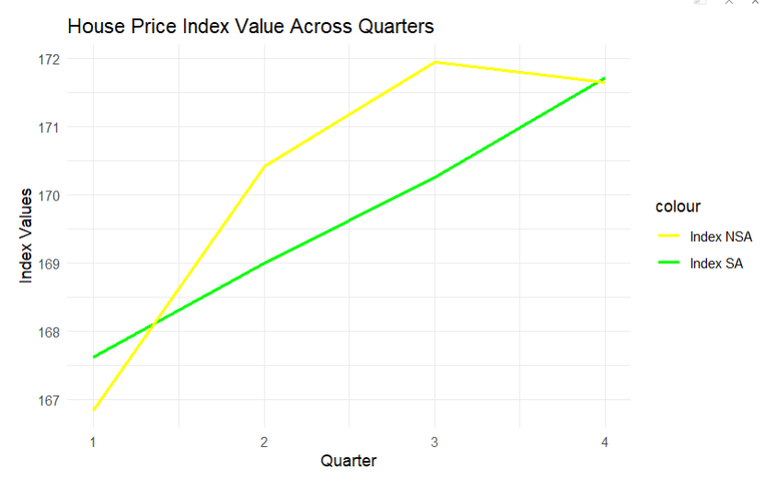
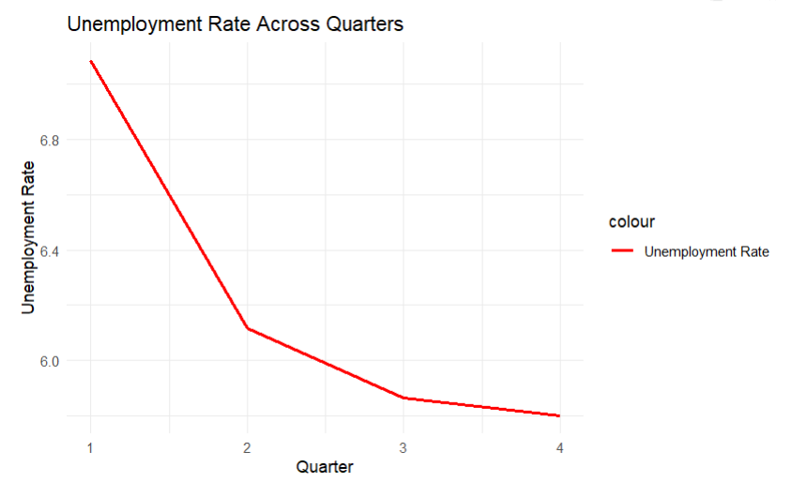
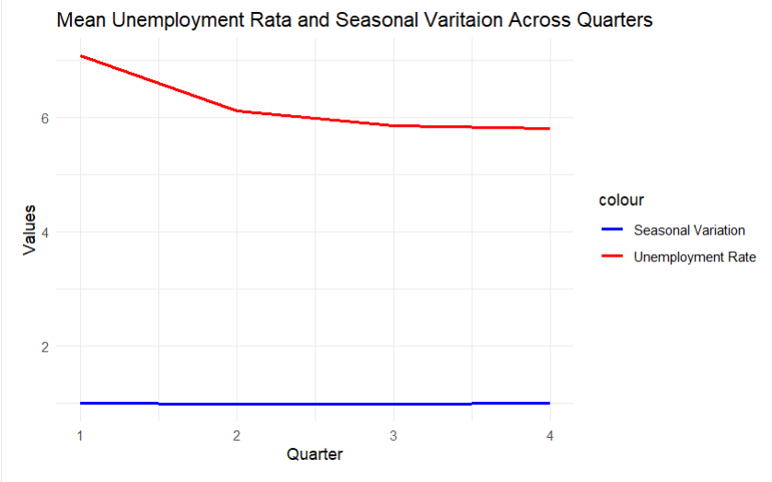

Slide 9
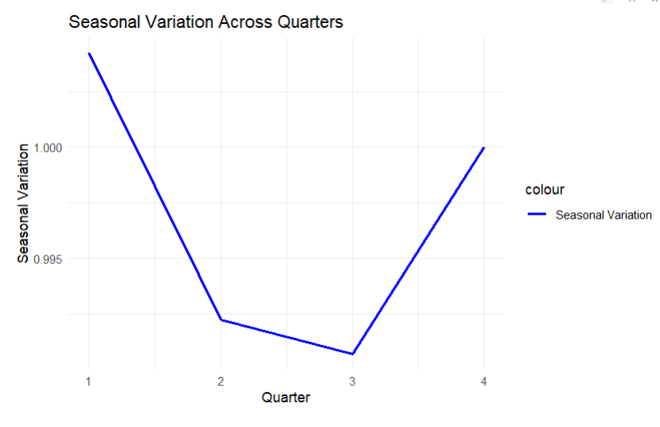
House price index fluctuations in the quarter.
The house price index has a linear relationship with the unemployment rate.
The trend of the seasonal variation has fluctuated, but not dramatically, in the past few decades.
The house price index doesn’t have a clear relationship across States.

Slide 10
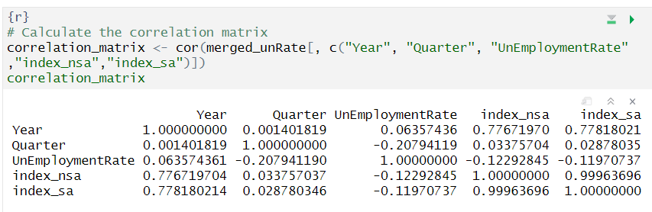
Variable Correlation Analysis

Slide 11
Principal Component Analysis (PCA)
The correlation coefficient between index_sa, and index_nsa is 0.999637, so we removed the redundancy one variable.
PCA is a dimensionality reduction technique that can be used to transform correlated variables into a set of uncorrelated variables (principal components).
Used the code “pca_result <- prcomp(merged_unRate[, c("index_sa", "index_nsa")])merged_unRate$house_price_index <- pca_result$x[, 1] ” to create a new variable “house price index” for our target value, and then use some prediction regression method to predict the house price index in the future.
We deleted the original variables “index_nsa” and “index_sa”.
Only the variables: UnEmploymentRate, house_price_index, Year, Quarter, and State are used in the next step of analysis.
We split the dataset into training and testing sets with an 80/20 ratio.

Slide 12
Prediction Models
1. Random Forest
2. Support Vector Regression
3. Linear Regression

Slide 13
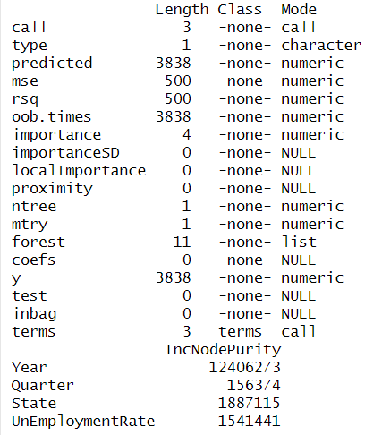

Random Forest Performance
[1] "Mean Squared Error:1181.59840065115"
[1] "R-squared: 0.782984578882919"
[1] "Mean Absolute Error: 23.7752556439841"

Slide 14
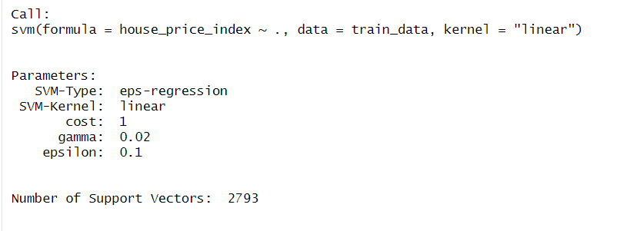
Support Vector Regression Performance
[1] "Mean Squared Error: 1229.63549954968"
[1] "R-squared: 0.779046259362823"
[1] "Mean Absolute Error: 24.8571453769854"

Slide 15
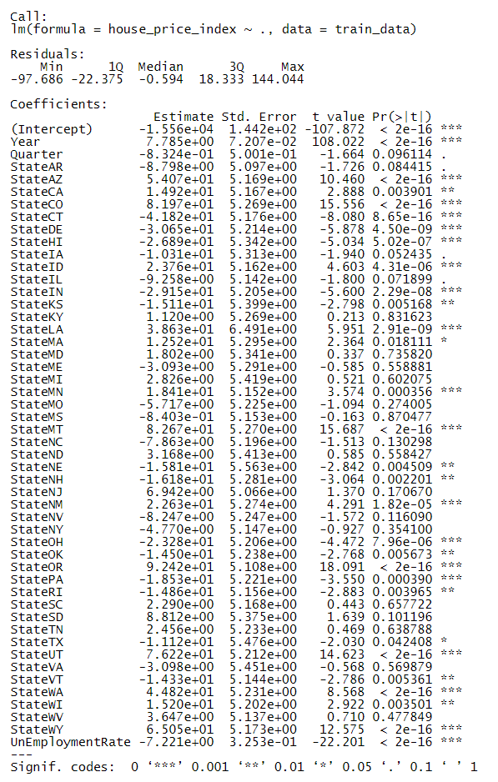

Linear Regression Performance
[1] "Mean Squared Error: 1083.0351484681"
[1] "R-squared: 0.80129502896619"
[1] "Mean Absolute Error: 25.414814343509"

Slide 16
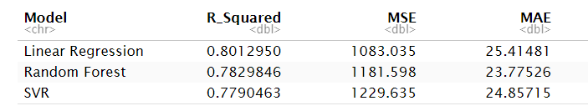
Conclusion
Based on the R squared value, the linear regression model performs best.
Based on the mean squared error, the linear regression model performs the best.
Based on the mean absolute error, the random forest model performs the best.
Overall, linear regression is the one prediction approach more fit with our data.

